Slide 1

FLIGHT FARE PREDICTION
Team :
G SAITEJA [ 20071A6918 ]
K LIKITH [ 20071A6925 ]
M. OJASVI [ 20071A6937 ]
P R K VASISTA [ 20071A6946 ]
VINEETH G [ 20071A6958 ]
Reviewer :
Mrs. NAGA DURGA SAILE
-Ass Professor

Slide 2
ABSTRACT
The "Flight Fare Prediction using ML" project aims to develop a machine learning model that can accurately predict the price of airline tickets. The project will utilize various data sources such as flight schedules, historical pricing data, and weather conditions to build and train the predictive model. The model will use advanced algorithms such as regression and decision trees to learn from the data and make predictions. The project's ultimate goal is to create a web application that can provide users with accurate and reliable flight fare predictions based on their travel requirements. This application can help travelers plan and budget their trips better and save money on airfare.

Slide 3
INTRODUCTION
Air travel has become an essential mode of transportation for many people worldwide, and as the number of travelers increases, so does the competition among airlines.
One of the most significant concerns for travelers is the unpredictability of airfare prices, which can fluctuate based on various factors such as demand, supply, fuel prices, time of year, and much more.
This unpredictability can make it challenging for travelers to plan their trips and budget their expenses effectively.

Slide 4
INTRODUCTION
The "Flight Fare Prediction using ML" project aims to address this issue by leveraging the power of machine learning to accurately predict airline ticket prices.
The project will use historical pricing data, flight schedules, and weather conditions to build a machine learning model that can learn from the data and make predictions.
The model will use advanced algorithms such as regression and decision trees to identify patterns and relationships between the data, allowing it to make predictions with high accuracy.
This application can help travelers plan their trips better, choose the best time to book flights, and save money on airfare.

Slide 5
dataset
Airline : So this column will have all the types of airlines like Indigo, Jet Airways, Air India, and many more.
Date_of_Journey : This column will let us know about the date on which the passenger’s journey will start.
Source : This column holds the name of the place from where the passenger’s journey will start.
Destination : This column holds the name of the place to where passengers wanted to travel.
Route : Here we can know about that what is the route through which passengers have opted to travel from his/her source to their destination.

Slide 6
dataset
Arrival_Time : Arrival time is when the passenger will reach his/her destination.
Duration : Duration is the whole period that a flight will take to complete its journey from source to destination.
Total_Stops : This will let us know in how many places flights will stop there for the flight in the whole journey.
Additional_Info : In this column, we will get information about food, kind of food, and other amenities.
Price : Price of the flight for a complete journey including all the expenses before onboarding.

Slide 7
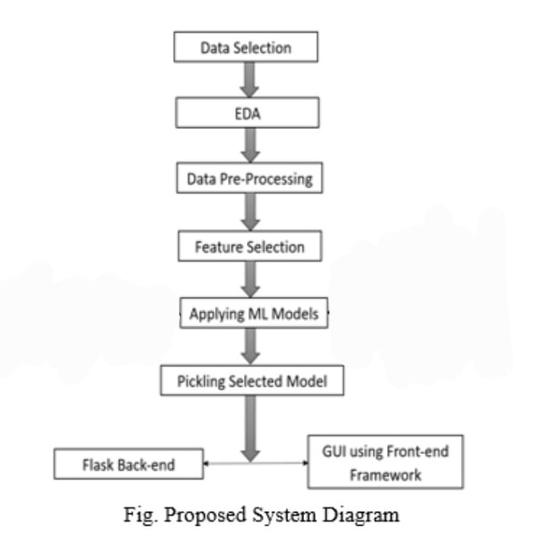
Proposed system

Slide 8
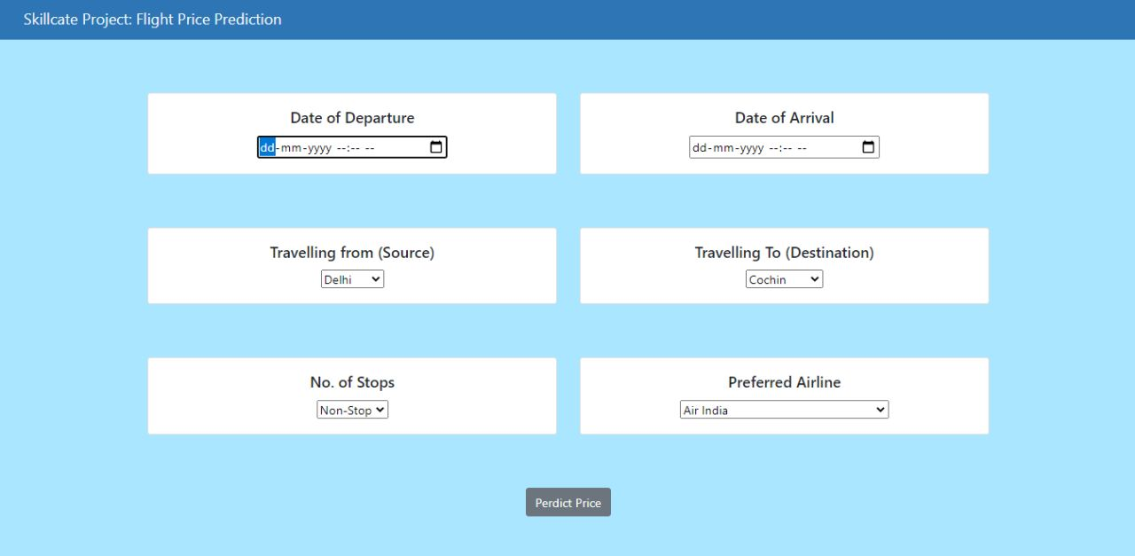
implementation

Slide 9
conclusion
We learn that ML models can be used to predict prices based on earlier data more correctly.
Our project reflects the dynamic change in the cost of flight tickets from which we get the information about the increase or decrease in the price as per the days, weekends, and the time of the day.
With the ML algorithm applied on various datasets, better results can be obtained for prediction.

